Slide 1
CMF Clearinghouse Rating Transition
Taha Saleem
UNC Highway Safety Research Center

Slide 2
Poll
Are you aware that the CMF Clearinghouse has transitioned to a new rating system?
Yes
No
Not Sure
Notes:
Before we begin, we have a Poll question for you.

Slide 3
CMF Clearinghouse Rating Transition

Slide 4
Why did the CMF Clearinghouse Transitioned to a New Rating Criteria?
The NCHRP 17-72 project recently developed a CMF rating system to update CMFs for the Highway Safety Manual
The CMF Clearinghouse rating system transitioned on Feb 15, 2021 to be consistent with the NCHRP 17-72 rating process
Account for Various Factors
Detailed / Rigorous
Notes:
Let us start with the big question. Why did the CMF Clearinghouse transitioning to a new rating criteria?
To give you guys a bit of a background, the legacy CMF Star Rating System has been in use since the inception of CMF Clearinghouse in 2009. Recently, the NCHRP 17-72 project developed a CMF rating system to update CMFs for the upcoming 2nd edition of the Highway Safety Manual. With this, the CMF Clearinghouse rating system transitioned on Feb 15, 2021 to be consistent with the NCHRP 17-72 rating scheme. This system is very detailed and rigorous, and provides scores for various factors.

Slide 5
Legacy CMF Star Rating System
Single rating scheme for Before/After, Cross-Sectional, Meta-Analysis, and Meta-Regression studies
CMFs were rated based on five criteria:
Study Design (weight of 2)
Sample Size (weight of 2)
Standard Error (weight of 1)
Potential Bias (weight of 1)
Data source (diversity in states) (weight of 1)
Points were assigned to each criteria based on the level of rigor (excellent = 2 points, fair = 1 point, or poor = 0 points) – Max 14 Points
Notes:
The legacy CMF Star Rating System used a single rating scheme to rate the CMFs developed from either Before/After, Cross-Sectional, Meta-Analysis, or Meta-Regression studies and that scheme was based on five criteria, that are, study design, sample size, standard error, biases, and data source. In this rating scheme, study design and sample size are given a weight of 2, whereas the other criteria’s carry a weight of 1.
Points are assigned to each criteria based on the level of rigor, where excellent equates to 2 points, fair equates to 1 point, and poor equates to 0 points.

Slide 6
Current CMF Clearinghouse Rating System
Before/After and Cross-Sectional studies:
Sample Size
Study Design and Statistical Methodology
Statistical Significance (standard error is used to determine statistical significance)
Meta-Analysis and Meta-Regression studies:
Methodology and Data
Individual CMF Quality
Appropriateness of Combining / Developing CMFunctions
Statistical significance / Appropriateness of Analysis
Maximum possible score is 150
Detailed scoring criteria is available at http://cmfclearinghouse.org/sqr.cfm
Notes:
The current (or the updated) CMF Clearinghouse rating systrem, provides separate rating criteria for CMFs developed using Before/After, Cross-Sectional, Meta-Analysis, and Meta-Regression studies.
The ratings for Before/After and Cross-Sectional studies consider factors such as the sample size, study design, methodology, and standard error of the CMF to determine significance.
Whereas the ratings for Meta-Analysis and Meta-Regression studies consider factors such as data, methodology, individual CMF quality, appropriateness of combining CMFs, significance, and the appropriateness of analysis.
There are multiple levels within the different factors, and points are assigned for each level for a maximum possible score of 150 points.
You can always visit the Star Quality Ratings page ate link displayed on the slide for more details about the rating criteria for all study types.

Slide 7
How have the Star Ratings Changed?

Slide 8
Star Ratings Changes
Score (legacy 14-point scale) | Star Rating in CMF Clearinghouse
14 (max) | 5 Star
11-13 | 4 Star
7-10 | 3 Star
3-6 | 2 Star
1-2 | 1 Star
Score (current 150-point scale) | Star Rating in CMF Clearinghouse
135-150 | 5 Star
110-134 | 4 Star
75-109 | 3 Star
35-74 | 2 Star
0-34 | 1 Star
The CMFs are not changing, only their Star ratings are changing
Under both rating systems, a CMF must score 50% of total possible points to receive a 3 Star rating
Notes:
The major change is going from a 14-point rating scale to a more rigorous 150-point rating scale.
Under the legacy rating system, to get a 5 star rating, a CMF must score the maximum possible 14 points. Using the current rating system, a CMF must score between 135-150 points to get for a 5 star rating.
Note that, while star ratings may have changed under the current system, the CMFs themselves haven’t.
One thing that is common Under both rating systems, is that a CMF must score 50% of total possible points — 7 points in the lehacy system and 75 points in the current one — to receive a 3 Star rating.

Slide 9
Poll
On a scale of 1 (not important) to 5 (very important), please rate the relative importance of the CMF star quality ratings to you and your work?
5 (very important)
4 (somewhat important)
3 (indifferent)
2 (less important)
1 (unimportant)

Slide 10
Resources to Better Understand the Rating Changes
Notes:
We understand that users have been using the CMF Clearinghouse star ratings to inform their decision making. The transition to the current rating system has led to few instances where the star rating for current CMFs have changed (there were some higher rated CMFs that score low under the current rating system, as well as some lower rated CMFs that score high under the current rating criteria).
To minimize the impact of these changes, we have included provided resources for users to better understand these changes.

Slide 11
Updated CMF Star Ratings Page
http://www.cmfclearinghouse.org/changes.cfm
Notes:
All resources and FAQs related to the CMF Rating Criteria Change

Slide 12
Comparison Spreadsheet
http://www.cmfclearinghouse.org/collateral/Ratings_Comparison.xlsx
Notes:
We also have a ratings comparison spreadsheet (available on the updated CMF Star Ratings page and downloadable using the link shown on this slide). This spreadsheet provides both the legacy and the current ratings for all CMFs (prior to the rating transition) and is a tool you would use to identify any star rating changes to your CMF of interest.

Slide 13
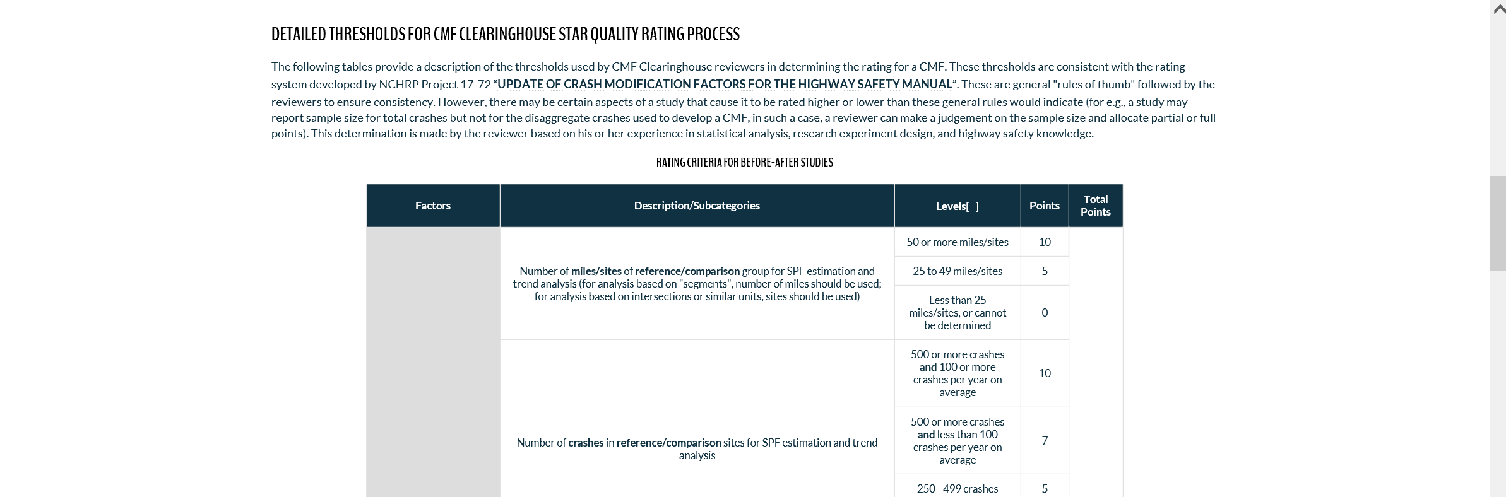
Star Quality Rating Page
http://www.cmfclearinghouse.org/sqr.cfm
Notes:
The star quality ratings page (housed under About the Clearinghouse dropdown menu), provides details about the new rating system and the various thresholds a study must meet to get a higher star rating.

Slide 14
CMF Details Page
http://www.cmfclearinghouse.org/detail.cfm?facid=XXXXX
Replace XXXXX in the above URL with the CMF ID
Notes:
The CMF Details page provides the star quality rating and the total rating points a CMF received along with other relevant information to aid in CMF applicability decisions. There is also a View Score Details link, clicking on it opens a new window with details on how the CMF fared under the various rating categories.

Slide 15
Score Details
Notes:
Here is the example of the Score Details page. Presented here are the information on all rating inputs for the various factors and their subsequent rating scores.

Slide 16
Q & A
Enter questions using the GoToWebinar window

Slide 17
Taha Saleem, PhD
UNC Highway Safety Research Center
919-962-3409
saleem@hsrc.unc.edu

